Slide 1
Section 8: Recursion, Search and Backtracking
Extension
Xiaofan Chen
x.chen3@massey.ac.nz

Slide 2
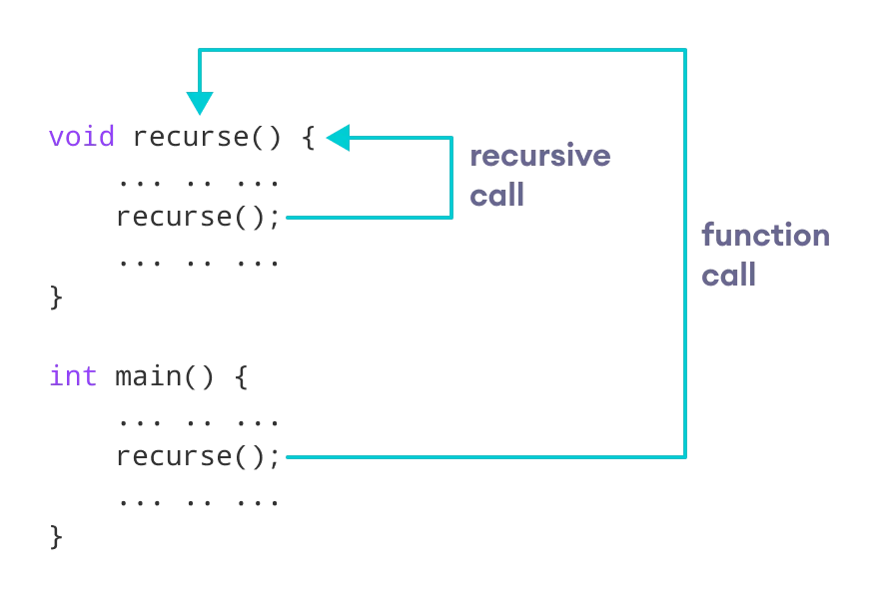
Recursion
Recursion: a statement in a function calls itself repeatedly
https://www.programiz.com/cpp-programming/recursion

Slide 3
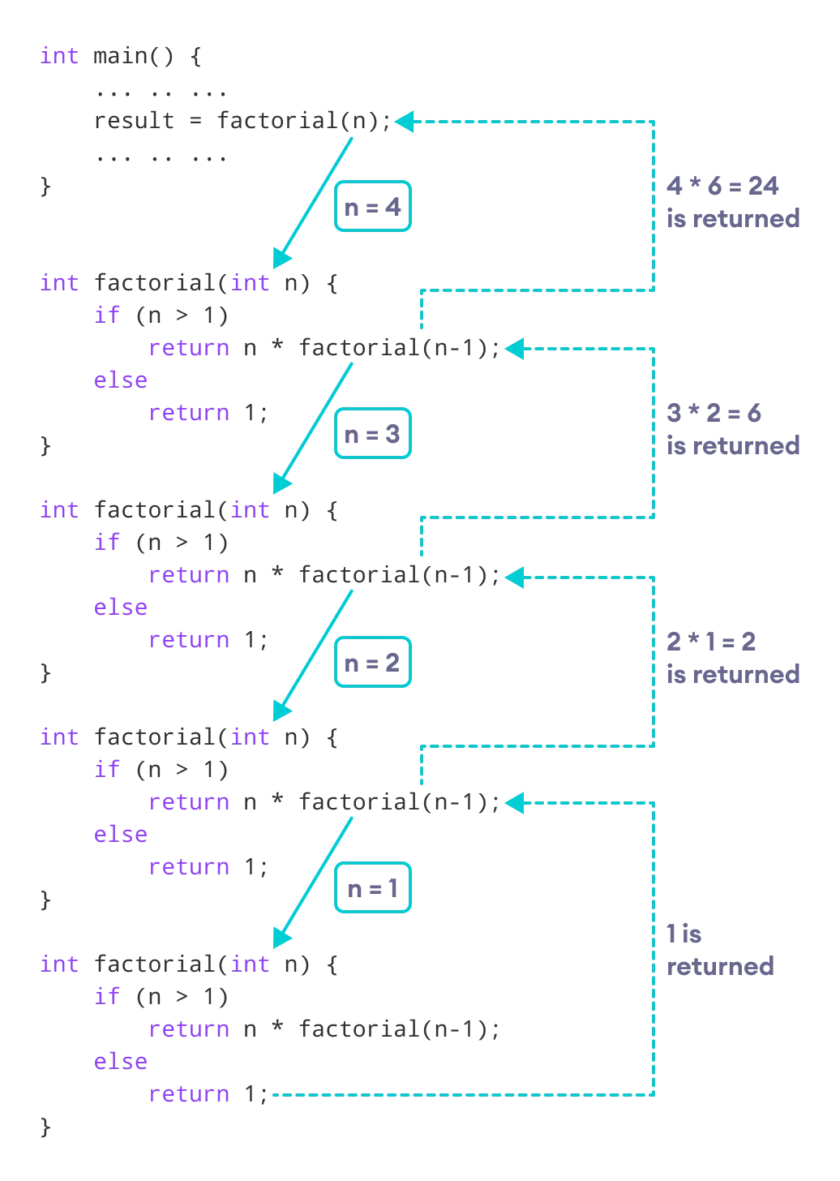
Recursion Example: Factorial
Factorial Formula:
  n! = n(n - 1)(n - 2) ... 2..1
Factorial of 4:
  4! = 4*3*2*1
Factorial of 5:
  5! = 5 * 4!
https://www.programiz.com/cpp-programming/recursion

Slide 4
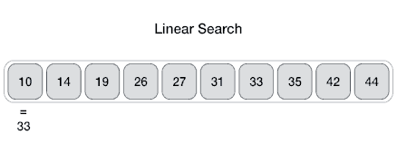
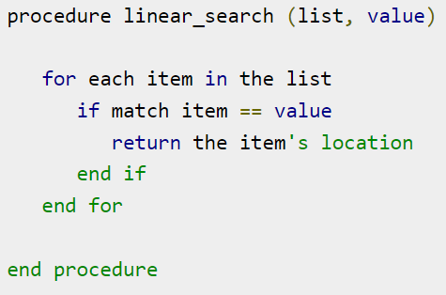
Linear Search
Iterate through the list to locate the matched item
Time complexity: O(n)
https://www.tutorialspoint.com/data_structures_algorithms/linear_search_algorithm.htm

Slide 5

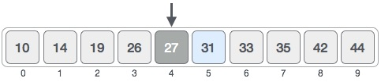

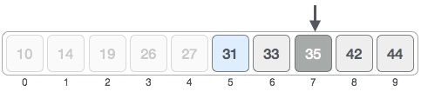

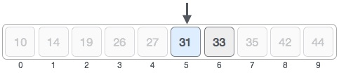

Binary Search
Search for 31
mid = low + (high - low) / 2
mid = 0 + (9 - 0 ) / 2 = 4
Divide and Conquer
low = mid + 1 = 4 + 1 = 5
mid = low + (high - low) / 2
mid = 5 + (9 - 5 ) / 2 = 7
high = mid - 1 = 7 – 1 = 6
mid = low + (high - low) / 2
mid = 5 + (6 - 5 ) / 2 = 5
https://www.tutorialspoint.com/data_structures_algorithms/binary_search_algorithm.htm

Slide 6
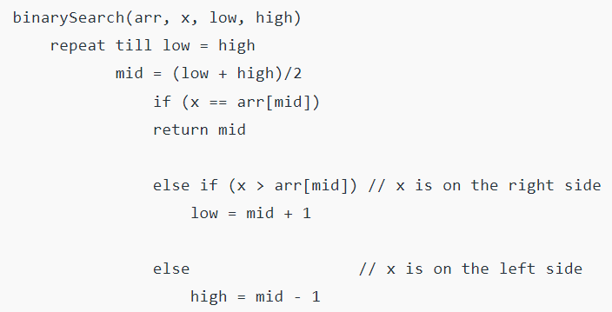
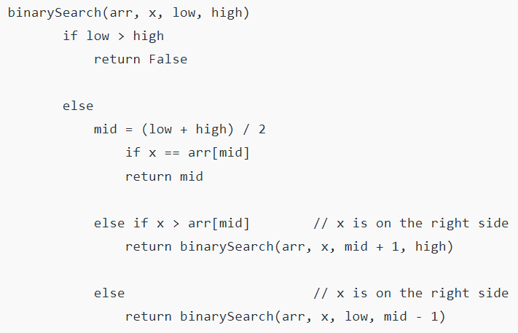
Binary Search: Pseudocode
Iteration
Time complexity: O(log n)
Recursion
https://www.geeksforgeeks.org/binary-search/?ref=lbp

Slide 7
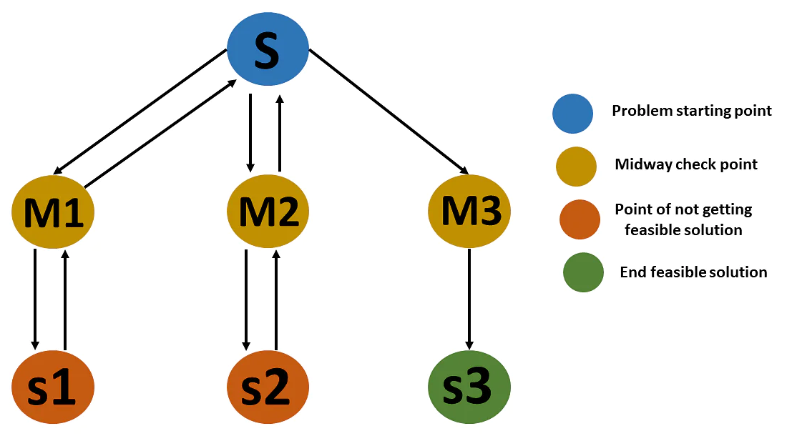
Backtracking
Algorithm
  Step 1 − if the current point is a feasible solution, return success
  Step 2 − else if all paths are exhausted (i.e current point is an endpoint), return failure since we have no feasible solution.
  Step 3 − else if the current point is not an endpoint, backtrack and explore other points and repeat the above steps.
https://www.simplilearn.com/tutorials/data-structure-tutorial/backtracking-algorithm

